Slide 1





NEXT GEN EMPLOYABILITY PROGRAM
Creating a future-ready workforce
Team Members
College Name
Student Name : SREENATH VIKARAM M
Kingston Engineering College
Student ID : 511321104095

Slide 2

CAPSTONE PROJECT SHOWCASE
Next Gen Employability Program
Project Title
Building Bus Reservation System using Python and Django
Abstract | Problem Statement | Project Overview | Proposed Solution |
Technology Used | Modelling & Results | Conclusion

Slide 3
Next Gen Employability Program
Abstract
The Bus Reservation System built with Python and Django is a web application designed to streamline the process of booking bus tickets.
It allows users to search for available buses, view schedules, select seats, and make
reservations online. The system provides an intuitive interface for both passengers and administrators, enabling easy management of bookings, routes, and ticket availability.
With features like user authentication, payment integration, and real-time updates,
the Bus Reservation System offers a convenient and efficient solution for travelers and bus operators alike.
Source :

Slide 4
Next Gen Employability Program
Problem Statement
The problem statement for the Bus Reservation System project involves addressing the inefficiencies and limitations of traditional bus ticket booking processes.
These may include manual ticketing systems, long queues, limited access to bus schedules, and difficulty in managing bookings and payments.
The aim is to develop a comprehensive online platform that streamlines the booking process, provides real-time bus information, ensures secure transactions,
and enhances overall user experience for both passengers and bus operators.
Additionally, the system should offer administrative features for managing routes, schedules, seat availability, and generating reports to optimize bus operations.
Source :

Slide 5
Next Gen Employability Program
Project Overview
The Bus Reservation System project aims to create an efficient online platform for booking bus tickets, managing reservations, and providing real-time bus information.
This system will offer users the convenience of booking tickets from anywhere at any time, reducing the need for physical ticket counters and long queues. Users will be able to browse available bus
routes, select seats, make payments securely, and receive e-tickets instantly via email or SMS. Additionally, the system will include administrative features for bus operators to manage routes, schedules, seat availability, and generate reports for better operational insights.
Overall, the project aims to enhance the travel experience for passengers while optimizing bus operations for operators.
Source :

Slide 6
Next Gen Employability Program
Proposed Solution
.
The Bus Reservation System project aims to create a user-friendly web application using Python and Django, allowing passengers to search, book, and manage bus tickets online.
The system will feature real-time seat availability updates, secure payment processing, and administrative tools for route management.
By automating the booking process, it enhances convenience for users and streamlines operations for bus operators, improving overall efficiency in the transportation sector.
Source :

Slide 7
Next Gen Employability Program
IMPLEMENTATION STEPS
Requirements Gathering: Gather requirements from stakeholders to understand the functionalities and features needed in the bus reservation system.
System Design: Create a comprehensive design for the system architecture, database structure, and user interface.
Backend Development: Develop the backend logic using Python and Django framework to handle user authentication, bus management, reservation processing, etc.
Frontend Development: Implement the user interface using HTML, CSS, and JavaScript, integrating with Django templates to ensure a seamless user experience.
Database Implementation: Design and implement the database schema using Django's ORM (Object-Relational Mapping) to store data such as users, buses, reservations, etc.
Integration and Testing: Integrate the frontend and backend components, and thoroughly test the application to ensure functionality, usability, and reliability.
Deployment and Maintenance: Deploy the application to a production environment, and provide ongoing maintenance, updates, and support to ensure optimal performance and user satisfaction.
Source :

Slide 8
Next Gen Employability Program
PROJECT STRUCTURE
The project structure typically consists of directories for managing application logic, templates, static files, and configuration settings:
Main Directory: Contains project-level files like settings.py, urls.py, and manage.py.
App Directory: Contains individual Django applications for specific functionalities like user authentication, bus management, and reservations.
Templates Directory: Stores HTML templates for rendering dynamic content.
Static Directory: Holds static files like CSS, JavaScript, and images used in the frontend.
Media Directory: Stores user-uploaded files like profile pictures or ticket scans.
Virtual Environment: A directory for managing Python dependencies and ensuring project isolation.
Database Directory: Stores database files if using SQLite or migration files if using other databases like PostgreSQL.
Source :

Slide 9
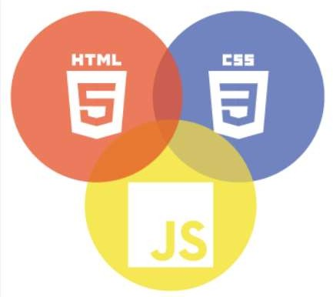

Next Gen Employability Program
Technology Used
Front-end
Back-end
Source :

Slide 10
Next Gen Employability Program
Modelling & Results
Modeling: Modeling in the Bus Reservation System involves defining the database schema using Django models. This includes creating classes for entities like buses, routes, bookings, and users, along with their attributes and relationships.
Result: The modeling phase results in a structured database schema that outlines the organization of data and the connections between different entities. This schema serves as the foundation for storing and managing information within the system, ensuring efficient data storage and retrieval operations.
Source :

Slide 11
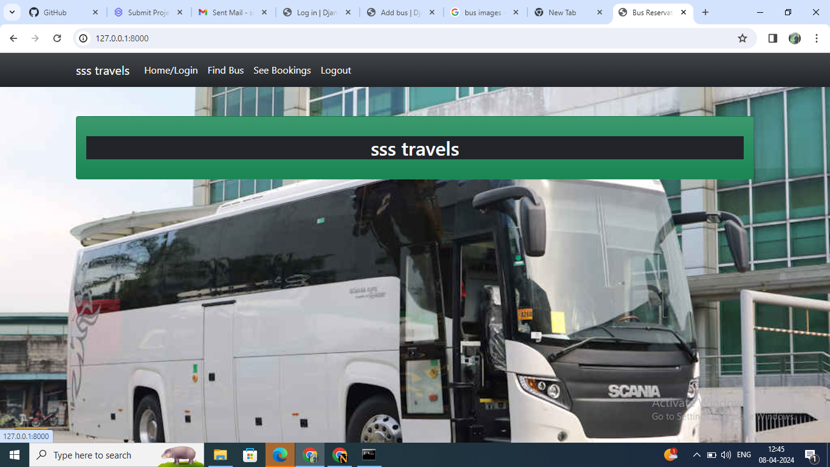
Homepage
Next Gen Employability Program

Slide 12
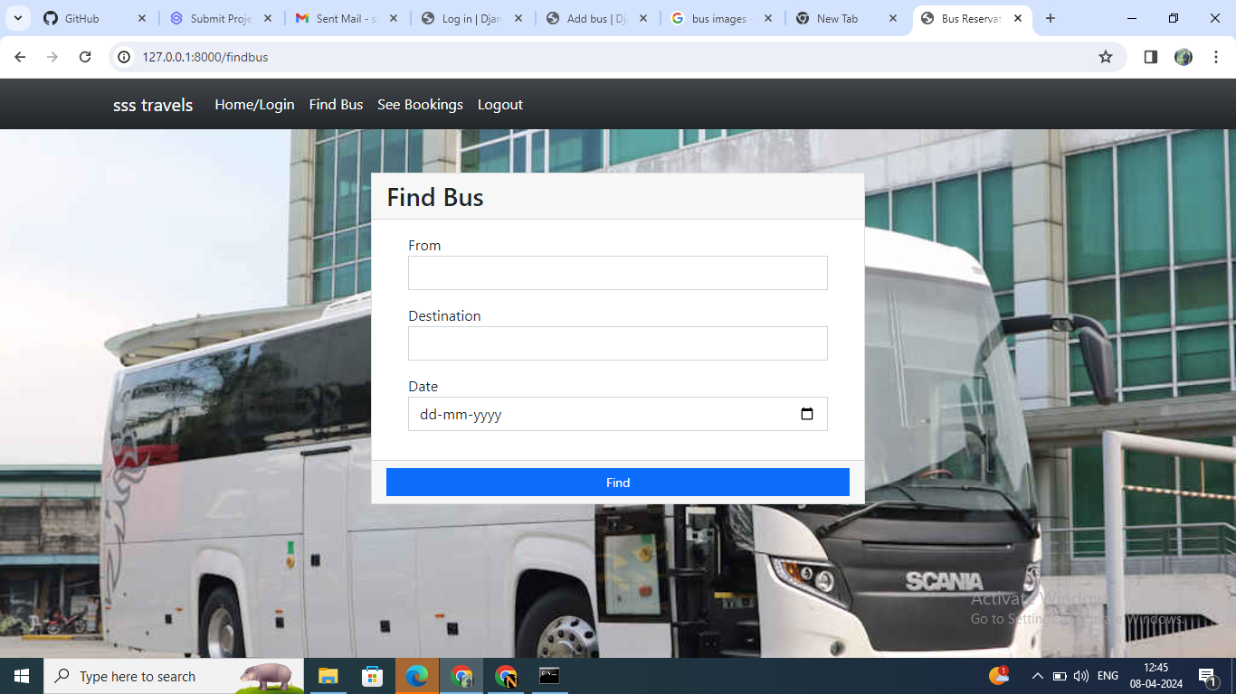
Next Gen Employability Program
Sevice-page

Slide 13
Next Gen Employability Program
FUTURE ENHANCEMENT
Integration of real-time bus tracking and GPS functionalities to provide accurate bus locations to passengers.
Implementation of a feedback system for passengers to rate their travel experience and provide comments, helping to improve service quality.
Development of a mobile application for easier access and booking on-the-go.
Integration of payment gateways to allow online payments for ticket booking, enhancing convenience for users.
Incorporation of dynamic pricing algorithms based on demand and availability to optimize revenue and resource utilization.
Integration with third-party travel services to offer seamless intercity or international travel options.
Implementation of AI-powered chatbots for customer support, providing instant assistance and resolving queries efficiently.

Slide 14
Next Gen Employability Program
Conclusion
In conclusion, the Bus Reservation System developed using Python and Django provides an efficient platform for users to book bus tickets conveniently. Through this project, we have demonstrated the integration of essential features such as user authentication, ticket booking, and viewing past bookings. Additionally, the system offers a foundation for future enhancements, including real-time tracking, mobile application development, and dynamic pricing. Overall, this project showcases the potential of technology to streamline the bus reservation process and enhance the travel experience for passengers.
Source :

Slide 15
Thank You!
Next Gen Employability Program

